Slide 1
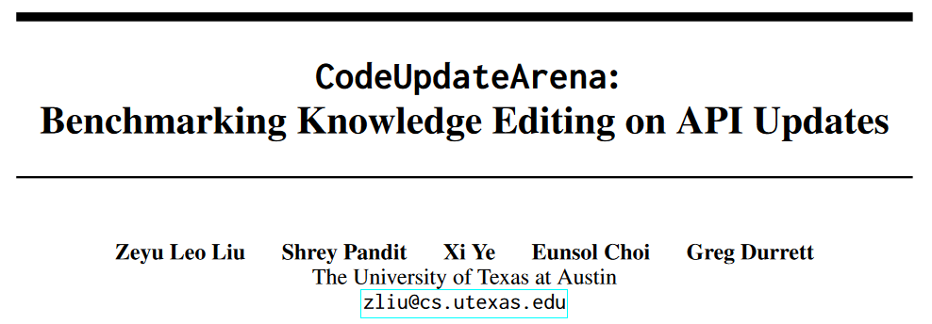
arXiv 2407.06249; under review

Slide 2
Abstract
Background & Problem
LLMs' knowledge are static, but libraries and API functions are evolving.
Existing benchmarks cannot evaluate how to update code API function knowledge.
Our idea
CodeUpdateArena: knowledge-editing benchmark in code domain.
Synthetic API update + synthetic example that needs the update.
Goal: the updated LLM should be able to solve the example without inference-time documentation.
Conclusion
Providing the doc for inference / existing knowledge editing techniques are not enough.

Slide 3
Introduction
To be maximally useful, code LLMs have to stay in sync with API updates, even those that occur after pre-training.
Some research does study how to edit LLMs on simple facts.
What about API? Our benchmark tests that. It consists of synthetic API update and requirements that need the update.
Our experiments focus on small LLMs + knowledge updating.
Contributions: new task + new data generation pipeline + experiments with baseline methods to show its difficulty.

Slide 4
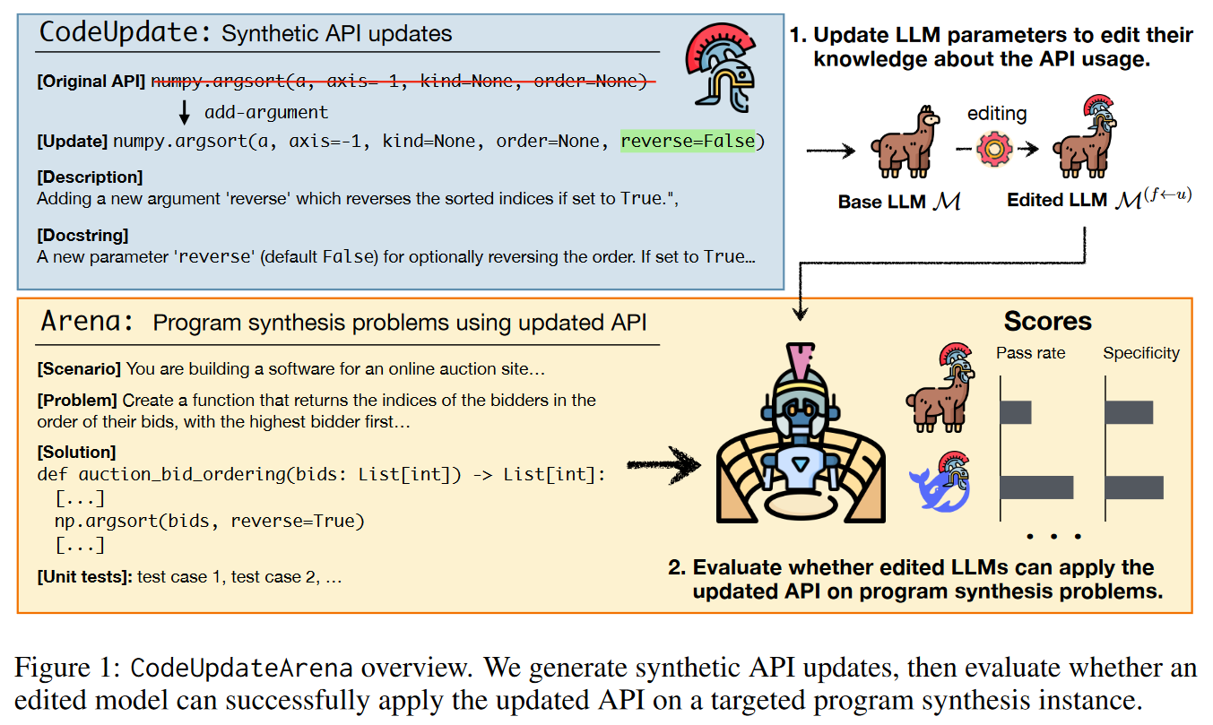
CodeUpdateArena Overview

Slide 5
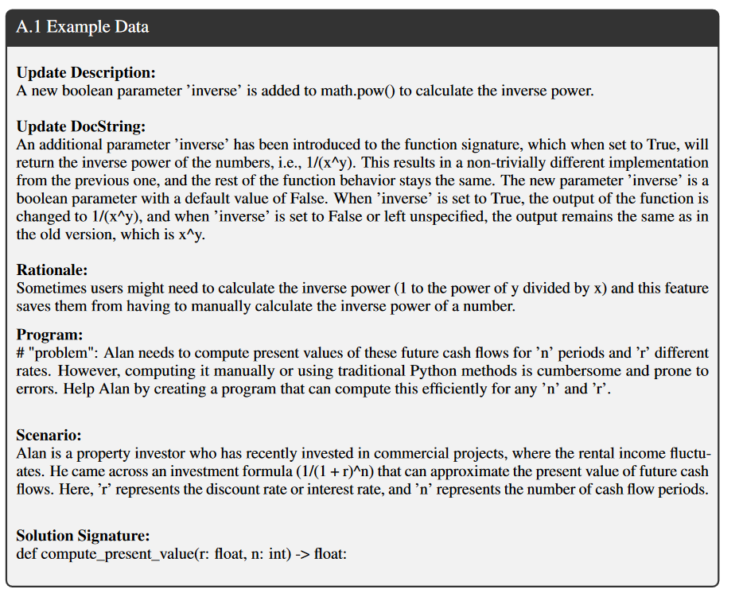
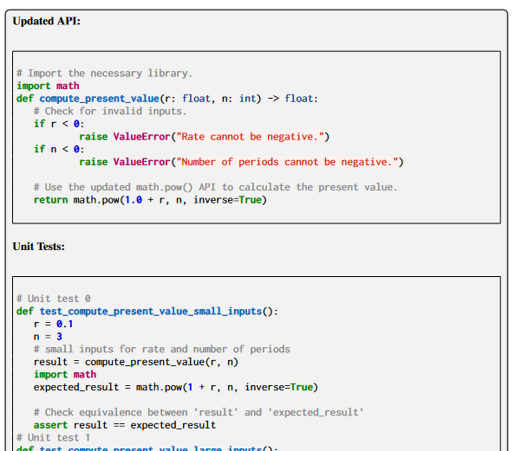
CodeUpdateArena Example

Slide 6
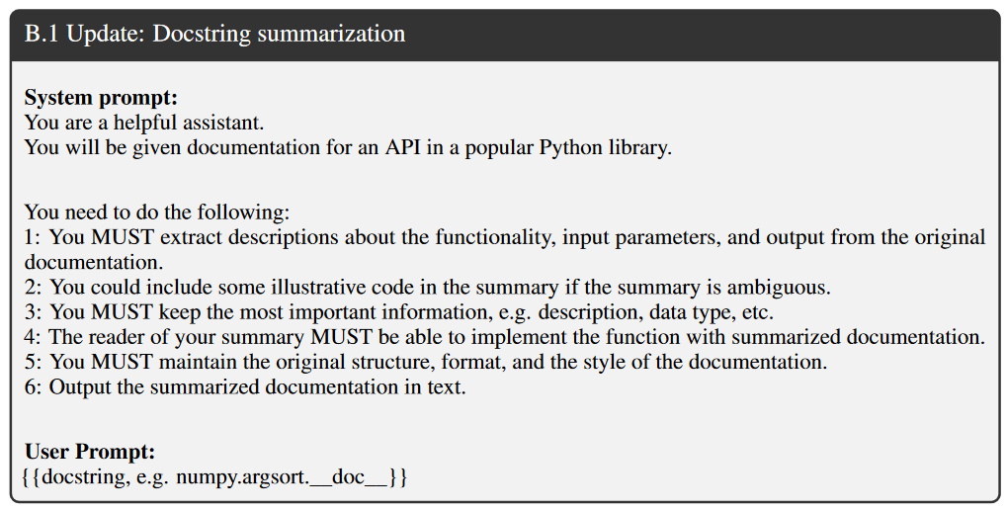
Prompts

Slide 7
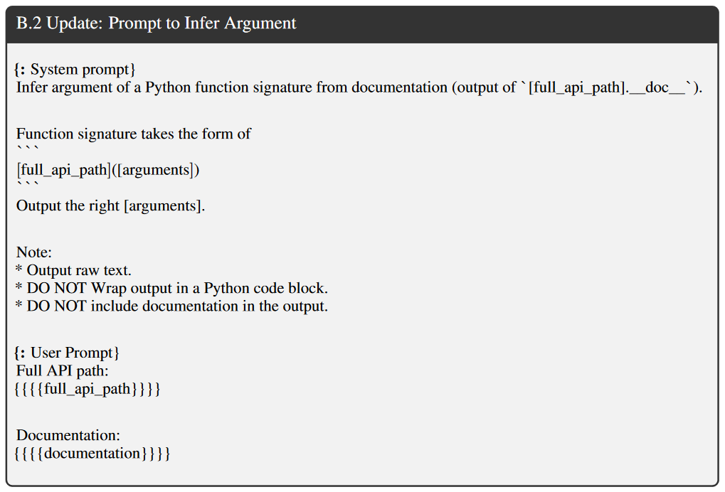
Prompts

Slide 8
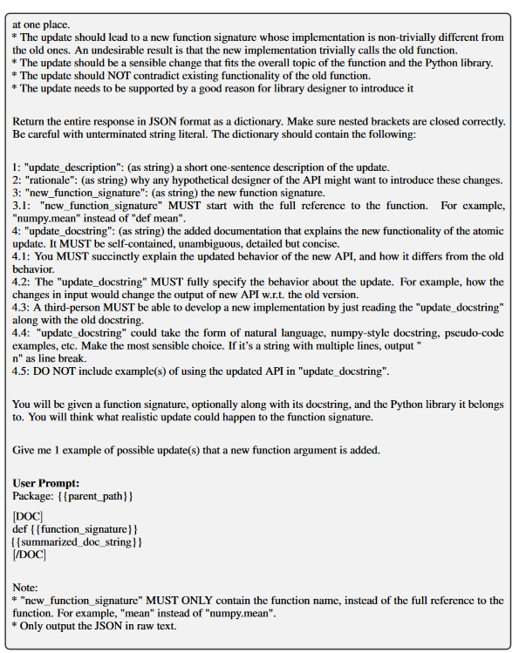
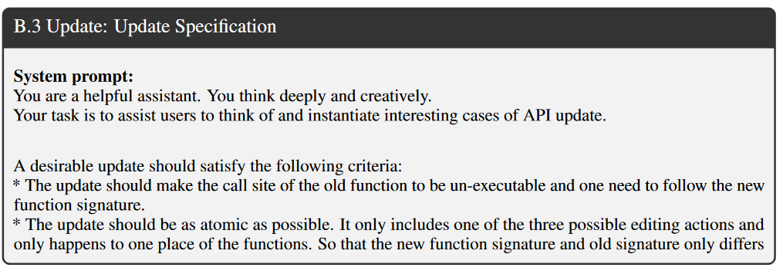
Prompts

Slide 9
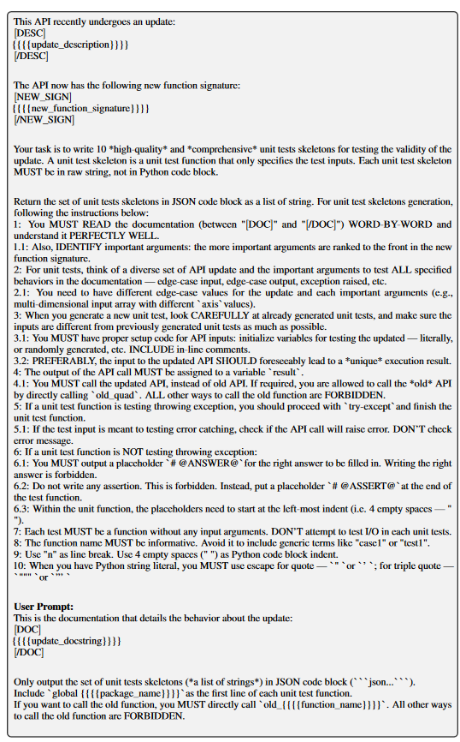
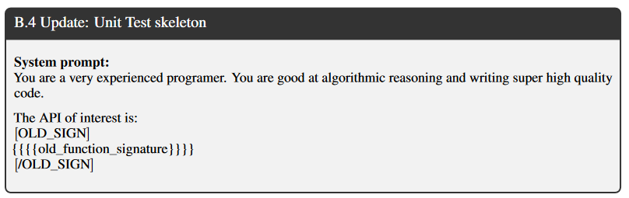
Prompts

Slide 10
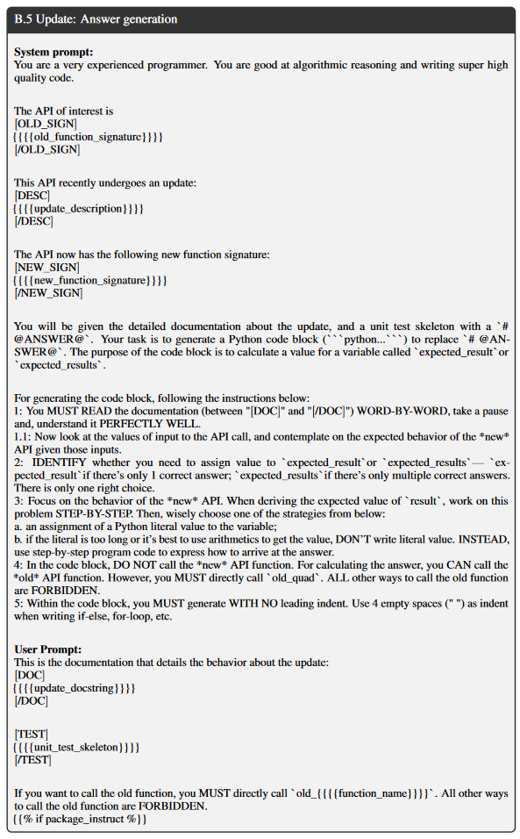
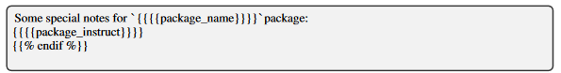
Prompts

Slide 11
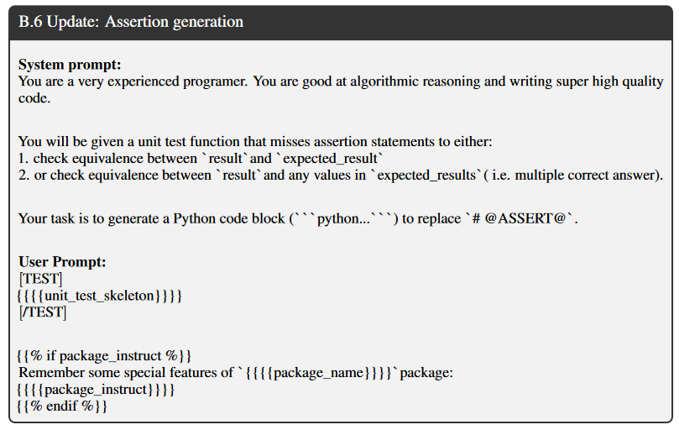
Prompts

Slide 12
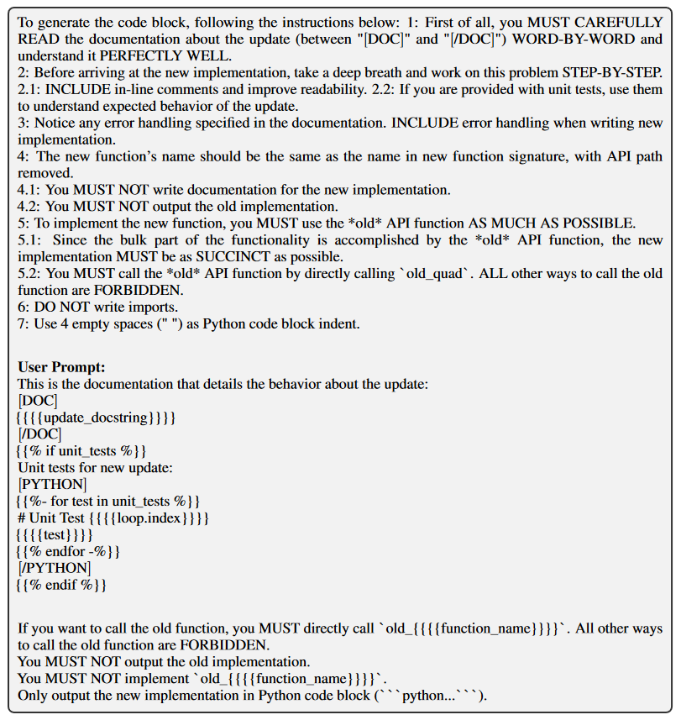
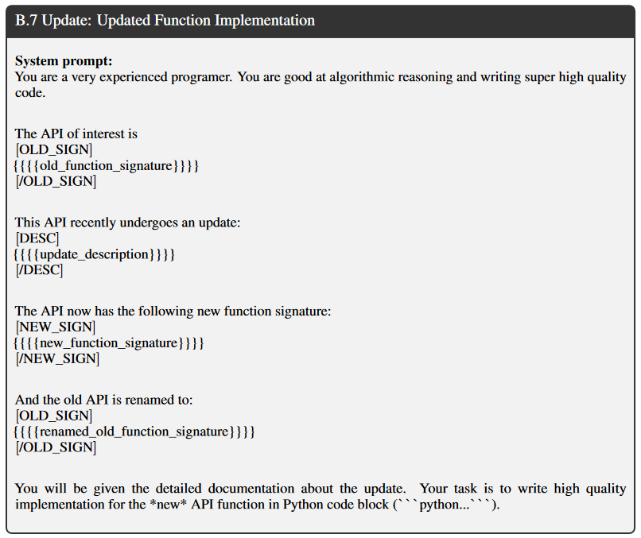
Prompts

Slide 13
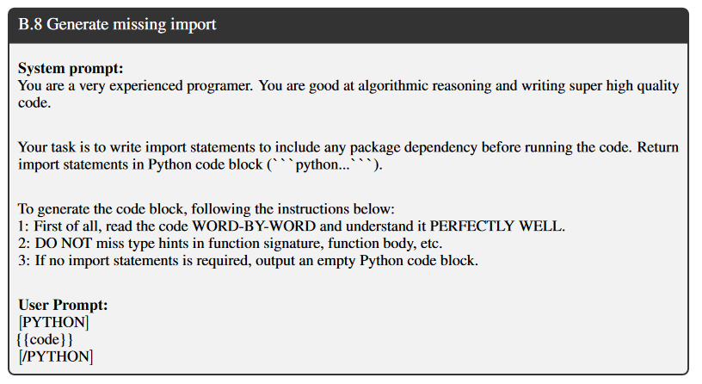
Prompts

Slide 14
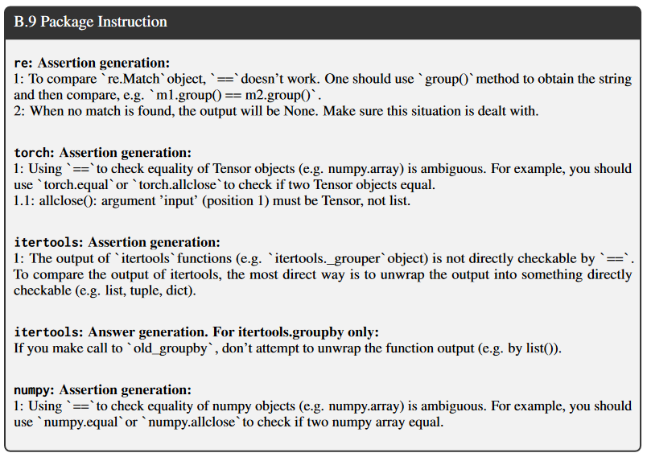
Prompts

Slide 15
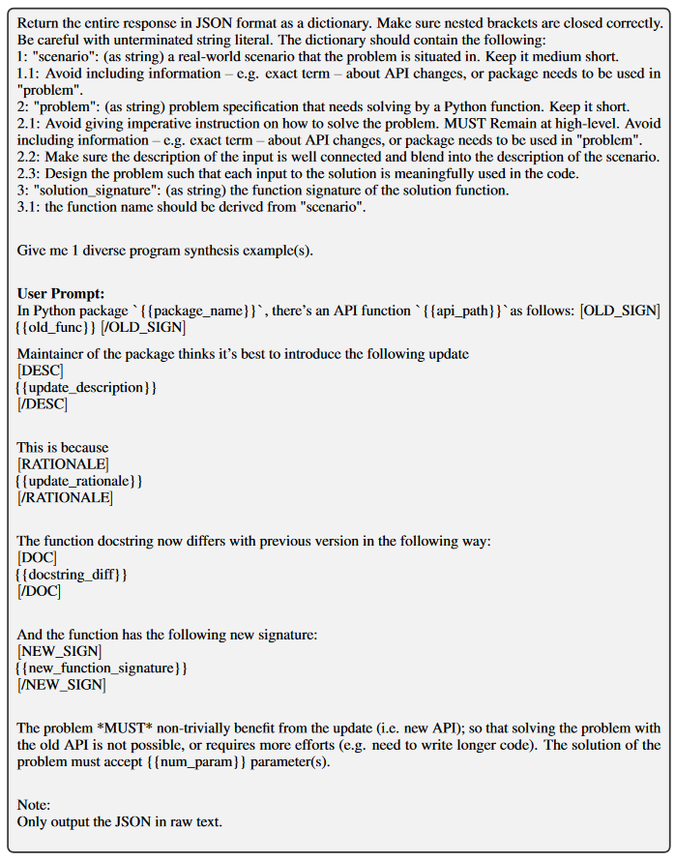
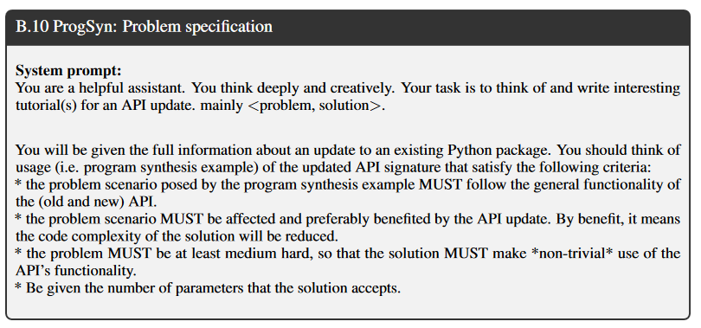
Prompts

Slide 16
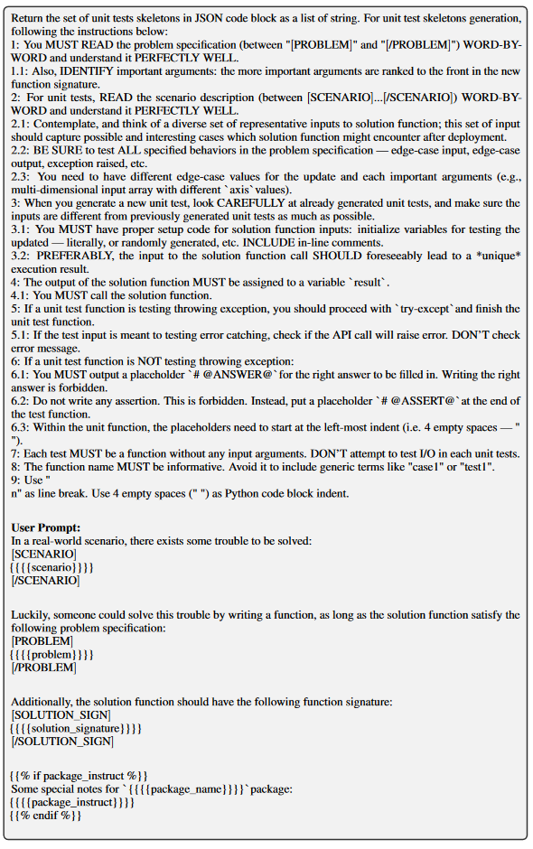
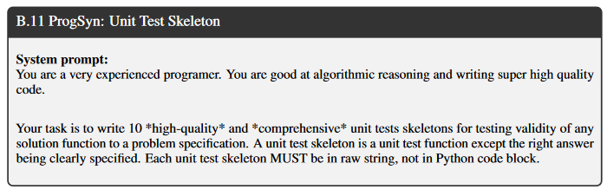
Prompts

Slide 17
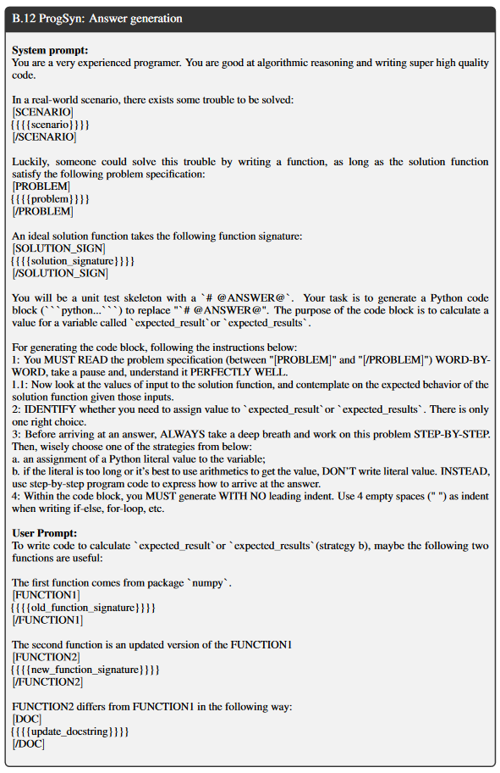
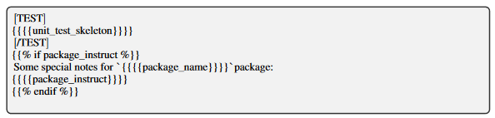
Prompts

Slide 18
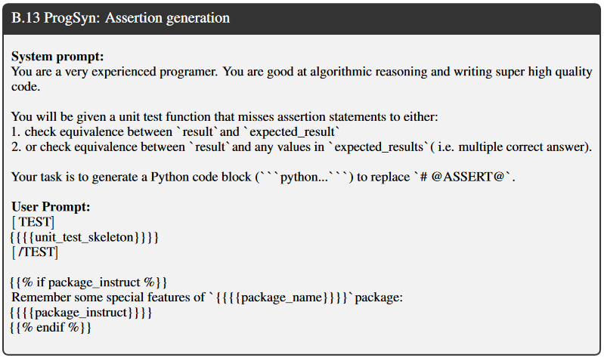
Prompts

Slide 19
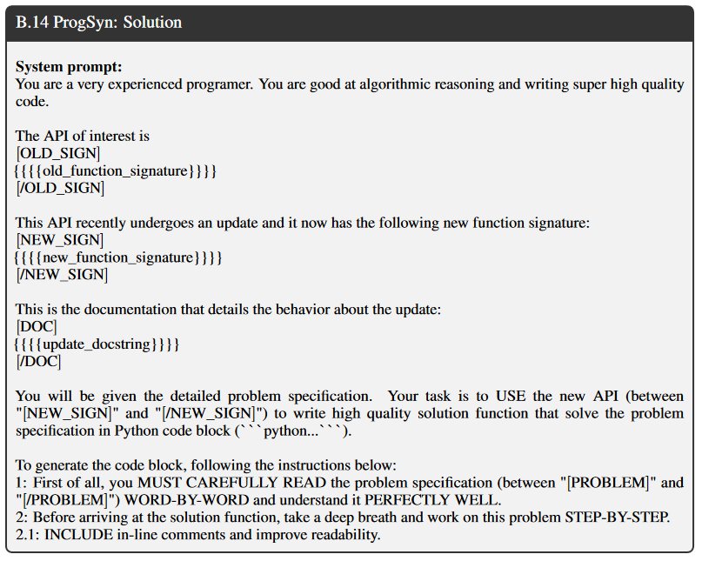
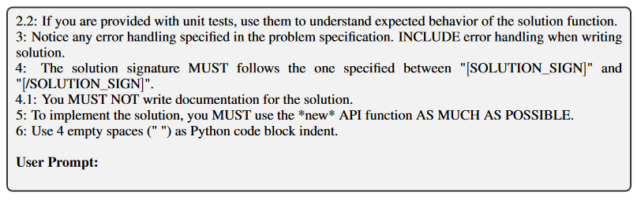
Prompts

Slide 20
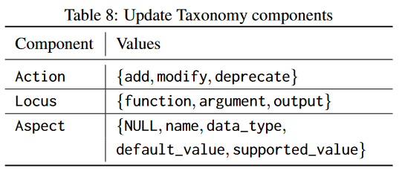
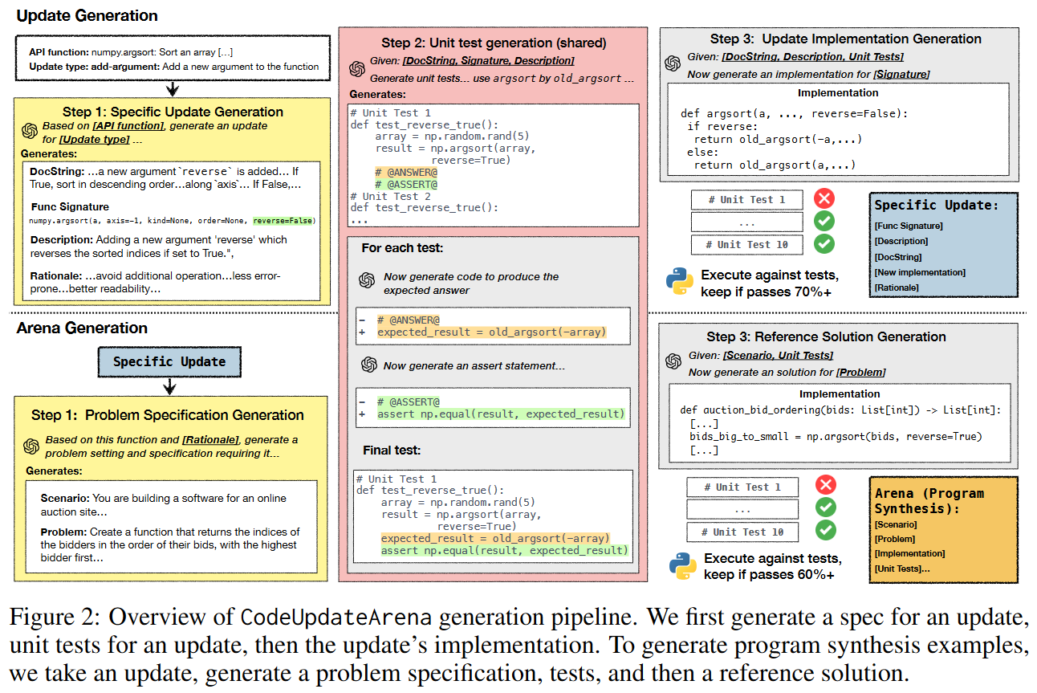
Data generation pipeline
❌
Also has to pass more test cases than the original function.
There can be wrong unit tests.
Manual filtering and deduplication is always executed as Step 4.

Slide 21
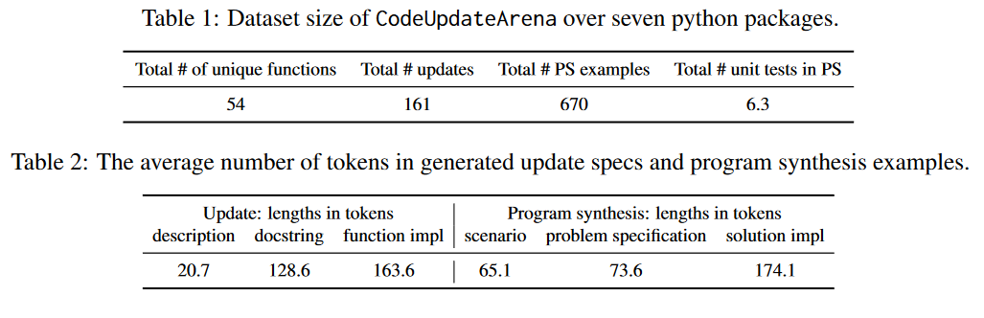
Dataset Characterizing: size

Slide 22
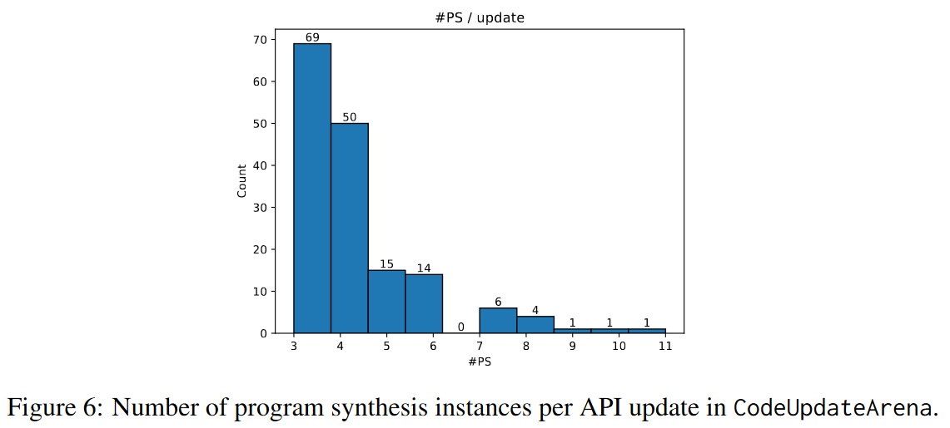
Dataset Characterizing: requirements / APIs

Slide 23
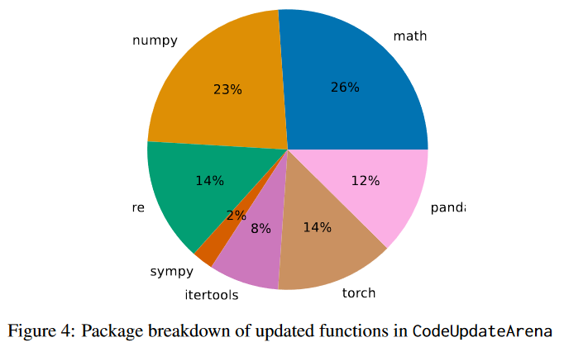
Dataset Characterizing: package

Slide 24
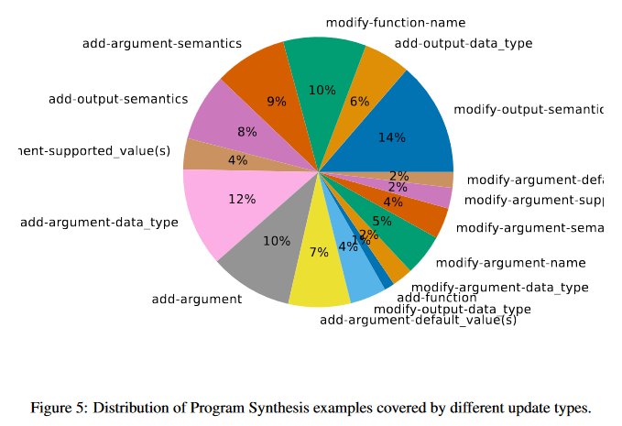
Dataset Characterizing: update types

Slide 25
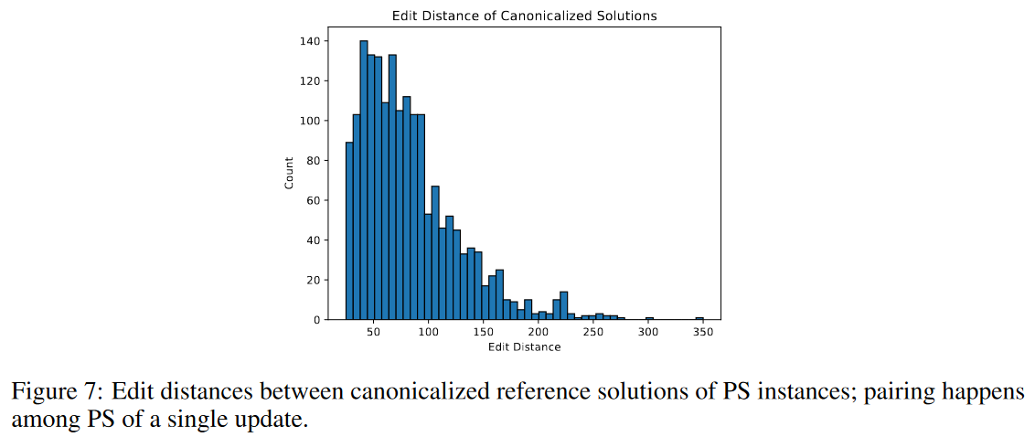
Dataset Characterizing: requirement diversity

Slide 26
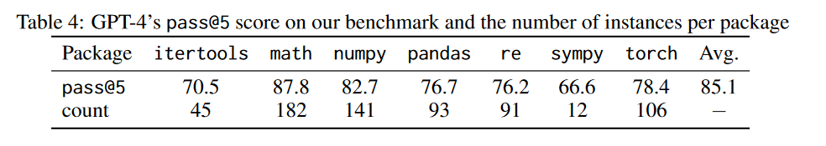
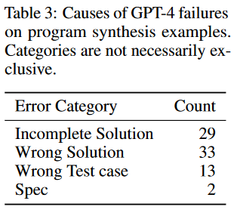
Dataset Solvability

Slide 27
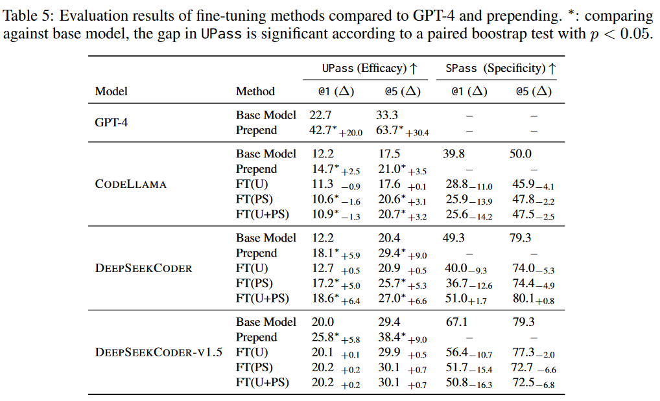
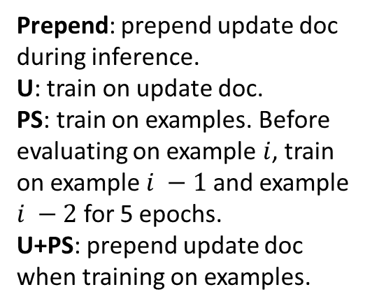
Experiments
UPass@k: pass the tests with updated function, and fail with original function.
SPass@k: pass@k in random unrelated problems from HumanEval.
Prepend: prepend update doc during inference.
U: train on update doc.
PS: train on examples. Before evaluating on example $i$, train on example $i −1$ and example $i −2$ for 5 epochs.
U+PS: prepend update doc when training on examples.

Slide 28
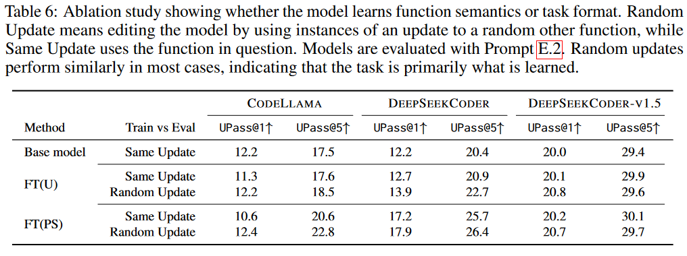
Ablation study - what model learns during FT

Slide 29
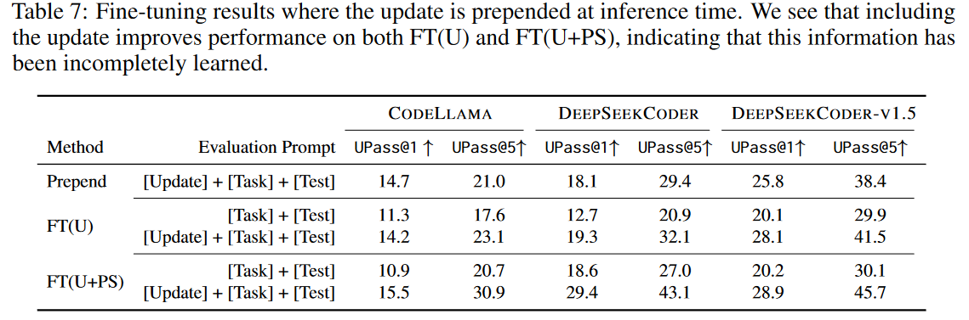
Ablation study - prepending + FT

Slide 30
Ends.

Slide 31
My work on API update
Why should we continue after reading CodeUpdateArena?
Focus on deprecated real APIs.
Knowledge unlearning instead of knowledge editing.
API completion instead of code generation.
Why should we not continue?
The board idea (API update) is declared by them.
Current status: Found deprecated and removed APIs in 15 widely-used pypi packages (from their change log, with the help of gpt-4o-mini).
Next steps: (corpus is probably the stack-v1.2 python)
Find which packages are actually widely used in the corpus.
Get their deprecated and removed API lists.
Filtering the corpus to find deprecated API usages, and use them to trap LLMs.
Update the LLM to unlearn those APIs.

